Slide 1
Learning Objective
I will be able to represent a set and evaluate set operations
Success Criteria
At the end of the lesson, I will be able to:
understand the following terms: set, element of a set, empty set, subset, universal set;
be able to define and use the following notations: union, intersection and complement;
know how to represent a set and evaluate set operations.

Slide 2
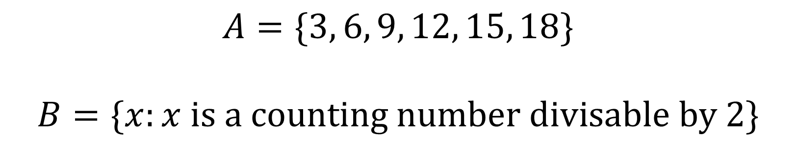
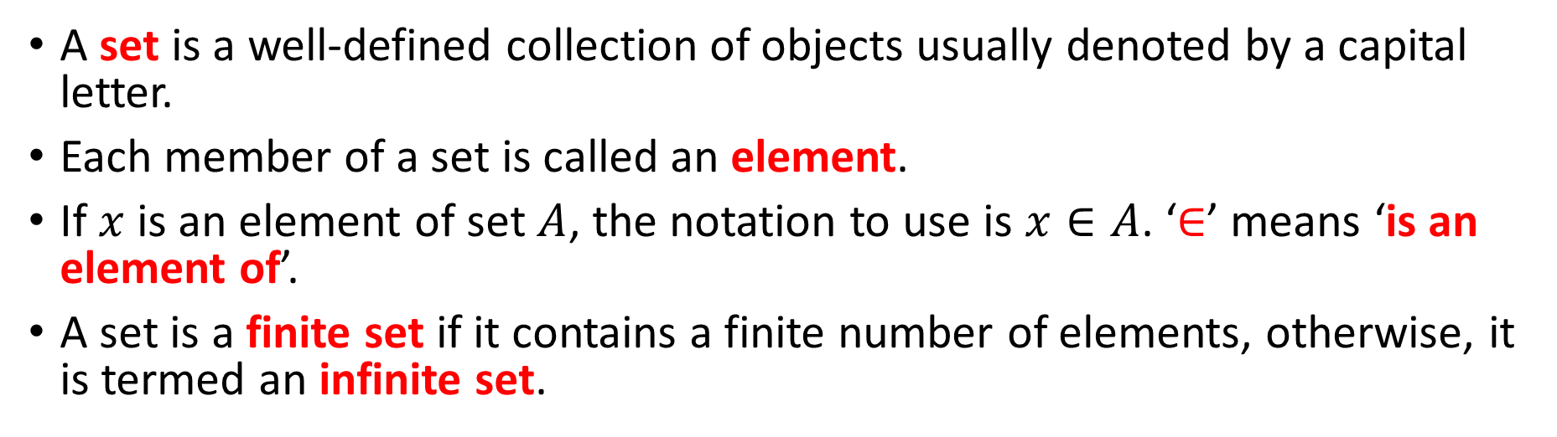
What is a set?
Concept Development
A set is a well-defined collection of objects usually denoted by a capital letter.
Each member of a set is called an element.
If $x$ is an element of set $A$, the notation to use is $x∈A$. ‘$∈$’ means ‘is an element of’.
A set is a finite set if it contains a finite number of elements, otherwise, it is termed an infinite set.
$$A=\{3, 6, 9, 12, 15, 18\}$$
$$B=\{x:x \text{is} \text{a} \text{counting} \text{number} \text{divisable} \text{by} 2\}$$

Slide 3
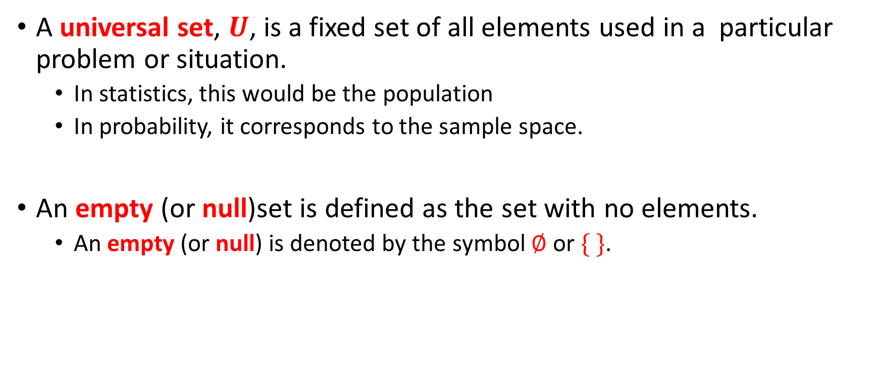
Universal and empty sets
Concept Development
A universal set, $U$, is a fixed set of all elements used in a particular problem or situation.
In statistics, this would be the population
In probability, it corresponds to the sample space.
An empty (or null)set is defined as the set with no elements.
An empty (or null) is denoted by the symbol $∅$ or $\{ \}$.

Slide 4

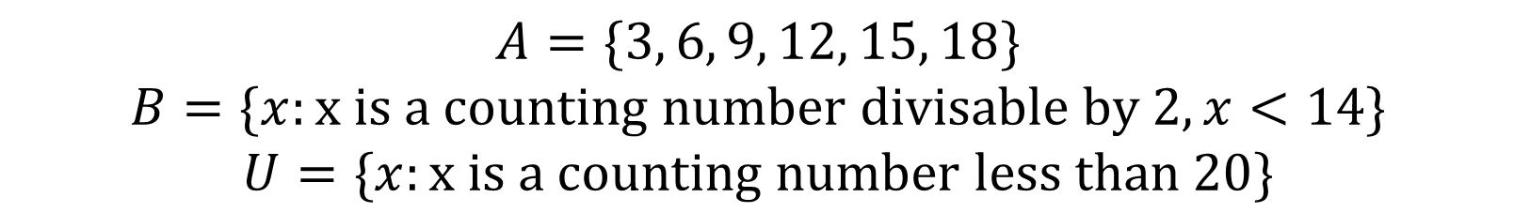


Using a Venn Diagram
Concept Development
$$A=\{3, 6, 9, 12, 15, 18\}$$
$$B=\{x:\text{x} \text{is} \text{a} \text{counting} \text{number} \text{divisable} \text{by} 2, x<14\}$$
$$U=\{x:\text{x} \text{is} \text{a} \text{counting} \text{number} \text{less} \text{than} 20\}$$
$$U$$
17
$$A$$
$$B$$
19
6
2
3
9
4
8
14
15
12
10
18
7
1
11
13
16
5

Slide 5
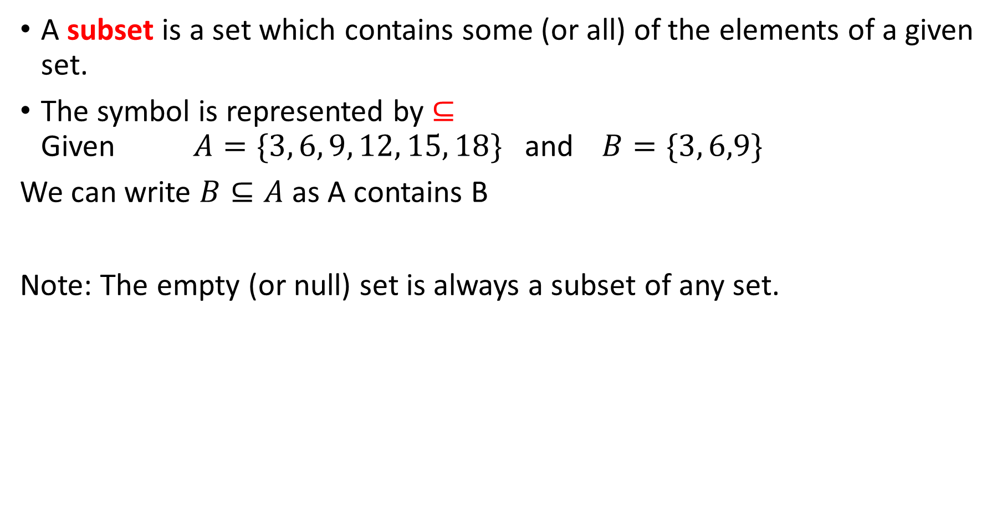
Subset
Concept Development
A subset is a set which contains some (or all) of the elements of a given set.
The symbol is represented by $⊆$ Given $A=\{3, 6, 9, 12, 15, 18\}$ and $B=\{3, 6,9\}$
We can write $B⊆A$ as A contains B
Note: The empty (or null) set is always a subset of any set.

Slide 6


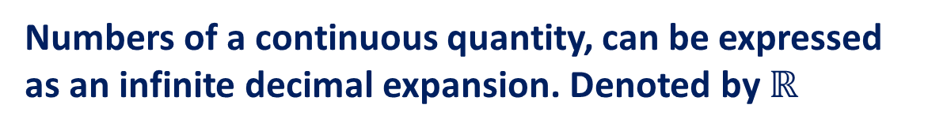






Vocabulary
Real Numbers:
Numbers of a continuous quantity, can be expressed as an infinite decimal expansion. Denoted by $ℝ$
Irrational Numbers:
Numbers that cannot be expressed in a fraction $\frac{p}{q}$ , with $p, q$ as integers.
Rational Numbers:
Numbers of the form $\frac{p}{q}$ , with $p, q$ as integers
Denoted by $ℚ$
Integers:
A whole number {… -2, -1, 0, 1, 2 … }
Denoted by $ℤ$
Natural Numbers:
Positive integers {1, 2, 3, 4 … }
Denoted by $ℕ$
$$ℕ$$
$$ℤ$$
$$ℚ$$
$$ℝ$$
$$ℕ⊆ℤ⊆ℚ⊆ℝ$$

Slide 7

Intersection and Union of sets A and B
Concept Development
Intersection of sets A and B denoted by $A∩B$ – consists of elements belonging to A and B
Union of sets A and B denoted by $A∩B$ – consists of elements belonging to A or B (Note – this will also include elements belonging to A and B.
A
B

Slide 8



Intersection, union and complement
Guided Practice
$$A=\{1, 2, 3, 5, 7, 11, 14\}$$
$$B=\left\{7, 11, 25, 30, 32\right\} \\ C=\{1,7,11,25,30\}$$
$$A⋂B$$
$$A⋂B⋂C$$
$$=\{7,11\}$$
$$=\{7,11\}$$

Slide 9



Intersection, union and complement
Guided Practice
$$A=\{1, 2, 3, 5, 7, 11, 14\}$$
$$B=\{7, 11, 25, 30, 32\}$$
$$C=\{1,7,11,25,30\}$$
$$A⋃B$$
$$B⋃C$$
$$=\{1,2,3,5,7,11,14,25,30,32\}$$
$$=\{1,7,11,25,30,32\}$$

Slide 10
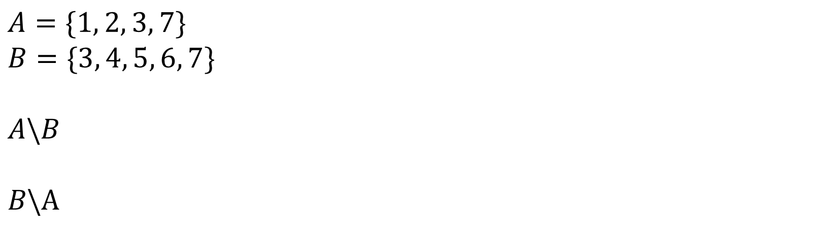
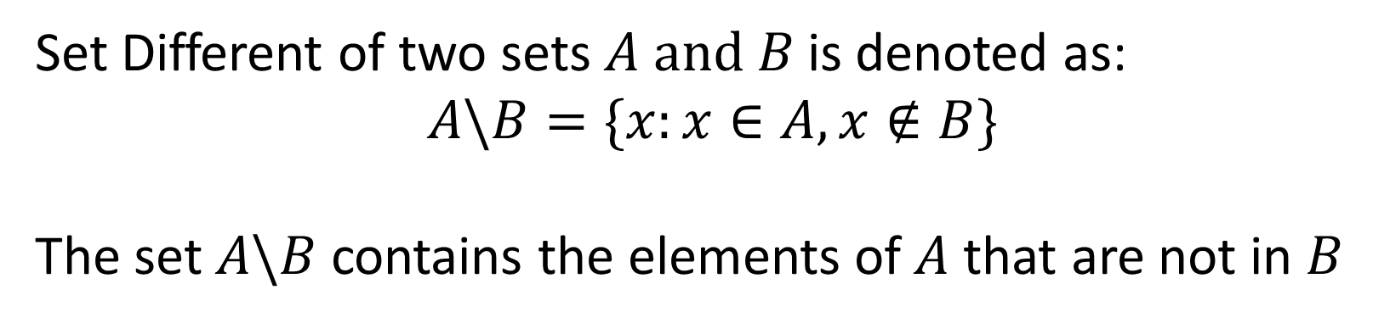


Set Difference
Concept Development
Set Different of two sets $A \text{and} B$ is denoted as:
$$A\backslash B=\{x:x∈A, x∉B\}$$
The set $A\backslash B$ contains the elements of $A$ that are not in $B$
$$A=\{1, 2, 3, 7\}$$
$$B=\{3, 4, 5, 6, 7\}$$
$$A\backslash B$$
$$B\backslash A$$
$$=\{1,2\}$$
$$=\{4,5,6\}$$

Slide 11












Interval Notation
Concept Development
$$(a,b)$$
$$=\{x:a<x<b\}$$
$$[a,b]$$
$$=\{x:a≤x≤b\}$$
$$(a,b]$$
$$=\{x:a<x≤b\}$$
$$[a,b)$$
$$=\{x:a≤x<b\}$$
$$(a,∞)$$
$$=\{x:a<x\}$$
$$(−∞,b]$$
$$=\{x:x≤b\}$$

Slide 12






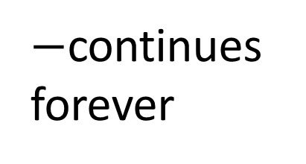

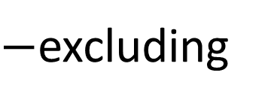
Illustrate the intervals on a number line
Guided Practice
$−$including
$−$excluding
$$[−2,3]$$
$−$continues forever
$$(−2,4)$$
$$(−3,4]$$
$$[−2,∞)$$
$$(3,∞)$$
$$(−∞,4]$$

Slide 13


Illustrate the intervals on a number line
Guided Practice
$−$including
$−$excluding
$$\left[−2,5\right], ℝ\backslash [−2,5]$$
$−$continues forever
$$\left(−∞,2\right]∪[4,∞)$$

Slide 14










Use the appropriate notation to describe each of the following sets
Guided Practice
$$\{x:−1≤x<2\}$$
$$[−1,2)$$
$$\{x:−4≤x≤2\}$$
$$[−4,2]$$
$$\{x:x>1\}$$
$$(−1,∞]$$
$$ℝ$$
$$(−∞,∞)$$
$$ℝ^{+}∪\{0\}$$
$$[0,∞)$$

Slide 15


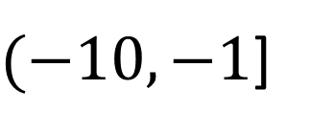

Describe each of the following intersections of intervals as simply as possible
Guided Practice
$$\left(−∞,−3\right)∩(−6,∞)$$
$$(−6,−3)$$
$$(−∞,−1]∩(−10,∞)$$
$(−10,−1$]

Slide 16
Independent Practice
Complete Ex 6A

